Slide 1
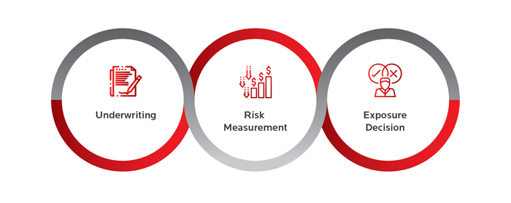

Home Loan Default- Risk Management using Machine Learning Approach
- A study of predicting Future Payment behavior of Clients from Application
Presented By: Team - PTID-CDS-MAY22-1315
Ankita Das anki.das23@gmail.com
Prasant Vijay Karn prasantvkarn@gmail.com
Kavita Desai kdarch14@gmail.com

Slide 2
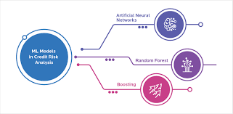
Why Use ML in Home Loan Defaulter Prediction?
This is case study understanding a particular bank loan defaulters. This bank give loan to applicants to those who can repay back or will ensure that they are capable of repaying back the loan. So this case study with the help of machine learning algorithms will identify the patterns for those applicants who may have difficulty in paying installments or be a defaulter.

Slide 3
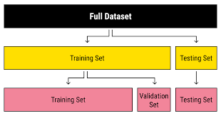
The Dataset
application_train.csv
previous_application.csv
bureau_balance.csv
bureau.csv
credit_card_balance.csv
installments_payments.csv
POS_CASH_balance.csv

Slide 4

EDA and Insights of Data
No. of defaulters: 24825
No. of non-defaulters: 282686
Percentage of defaulters: 8.072881945686495
It’s an imbalance Dataset. (Defaulter : Non-Defaulter = 8 : 92 = 2 : 23)
Percentage of applicants approved previously but are defaulter in current loan: 7.588655443691958
Percentage of applicants refused previously but are non-defaulter in current loan: 88.00358612820408
Most applications are approved. Cancelled and Refused are almost on the same level.
It’s a Binary Classification Problem.

Slide 5
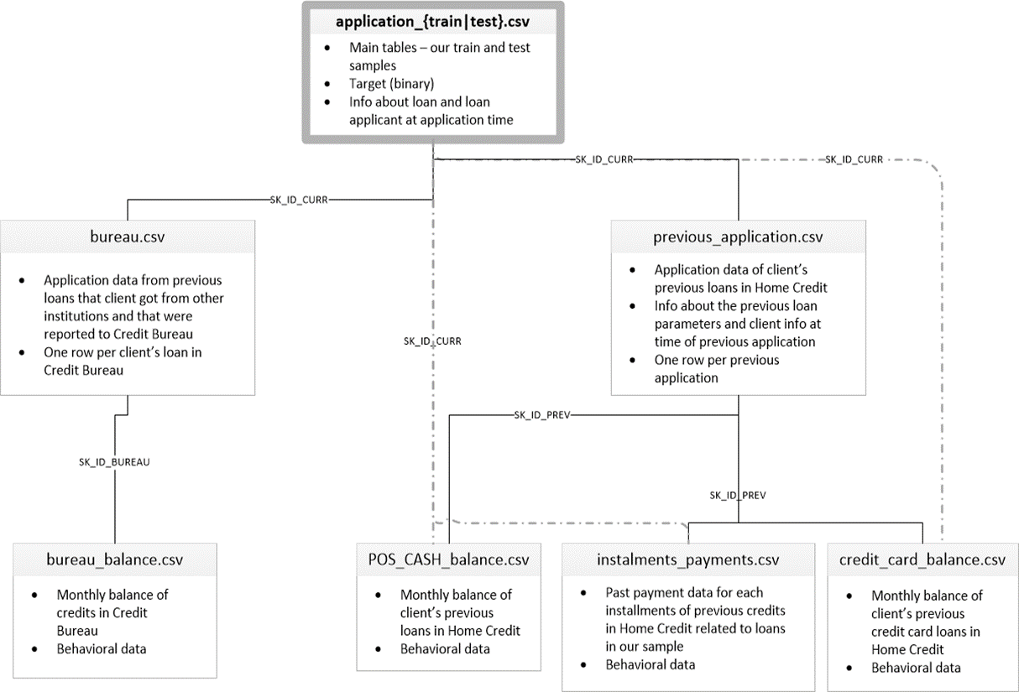
Merging of Files
Current Application- The shape of Current Application: (307511, 122)
Previous Application- The shape of Previous Applications: (1670214, 37)
Bureau- The shape of Bureau : (1716428, 17)
Bureau Balance- The shape of Bureau Balance: (27299925, 3)
Credit Balance- The shape of Credit Balance: (3840312, 23)
Instalment Payments- The shape of Install Payment: (13605401, 8)
POS- Cash- The shape of POS Cash: (10001358, 8)

Slide 6
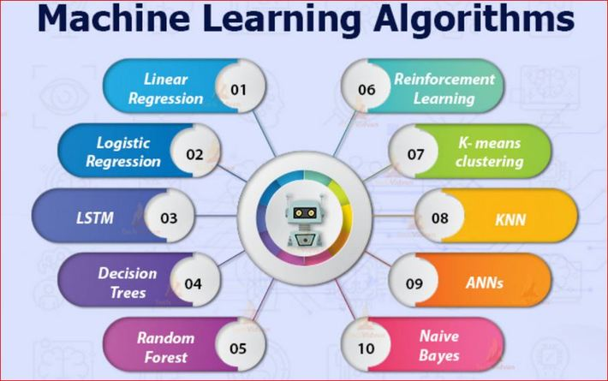
Model building
Logistic Regression -
The Recall score of Logistic Regression is 71.5%.
The AUC Score of Logistic Regression is 78%.
Random Forest -
The Recall score of Random Forest is 97.40%.
The AUC Score of Random Forest is 100%.
XGBoost -
The Recall Score of XGBoost is 92.5%
The AUC Score of XGBoost is 98%.

Slide 7
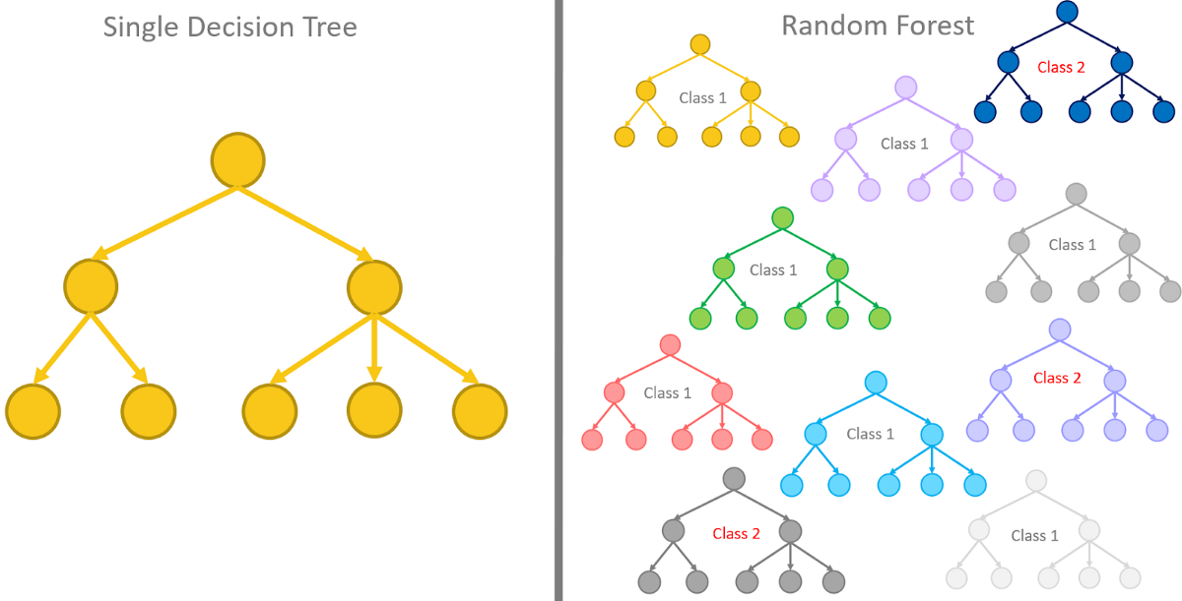
Conclusion
The highest Recall value was obtained for RandomForest, which is then followed by XGBoost Classifier Model.
The Highest ROC-AUC was observed for RandomForest Classifier, followed by XGBoost Classifier Model.

Slide 8
THE END

